Slide 1

[Samsung PRISM] END Review Report
WIRELESS SENSOR NETWORKS AN23
Team
College Professor(s): Dr. K PANIMOZHI, Dr. SUMA MN
Students:
DHERAJ SK
JAYANTH B
OM BHANDAKAR
PANKAJ SHARMA
Department: COMPUTER SCIENCE, ELECTRONICS AND COMM.
Date: 27 June 2023

Slide 2

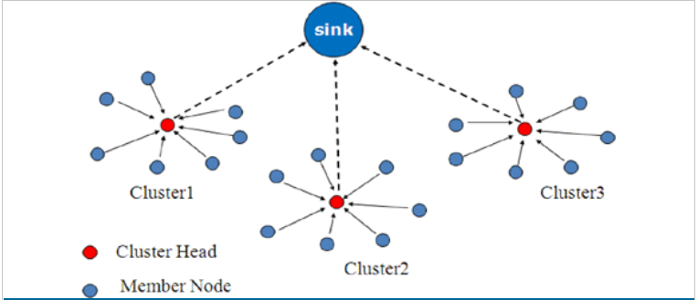
Wireless Sensor Networks
WSN is a network of several sensors usually installed at remote sites .
These networks collect, process and distribute wireless data to the intended database storage centres.
WSNs face many challenges such as network security threats, network architecture, data collection, Power consumptions, deployment and network coverage etc.
If we take case of Data collection , there have been many advancements in recent times with respect to its algorithm.
One such example is Clustering of sensor nodes to collect data and send to required database.
Example of one of clustering method of sensor nodes for Data collection.
Training/ Pre-requisites
Understanding of Wireless communication
Understanding of Wireless Sensor Networks
Tools: C or MATLAB for simulation
Student Learning
experience of WSN and its applications
experience of simulations of WSN
Expectations
Understand the WSNs , its applications, deployment methods in details
Design algorithm for efficient Data collection and distribution in WSN.
Simulation of the algorithm using suitable tool.
Contact us:
Know more:
https://en.wikipedia.org/wiki/Wireless_sensor_network
Dinesh Mahto
dinesh,.mahto@samsung.com
Kick Off
Submit your thoughts
~3 months
Ramp up and jump in!
Algorithm design and validation of efficient Data collection methods in WSN
Identifying designed algorithm gains with respect to existing methods.
~6 months
Algorithm refinement: Design of advanced alternatives for performance and complexity improvement.
Simulation ,result and conclusion.

Slide 3
Proposed Approach / Solution
Concept Diagram :
Network
Lifetime
Cluster Formation
Optimise Leach
PSO
WSN
Energy Efficient
Cluster Head Selection
Fault Tolerance
Integrated code for PSO and shortest path
Routing Protocols
Dijkstra algorithm
Security

Slide 4
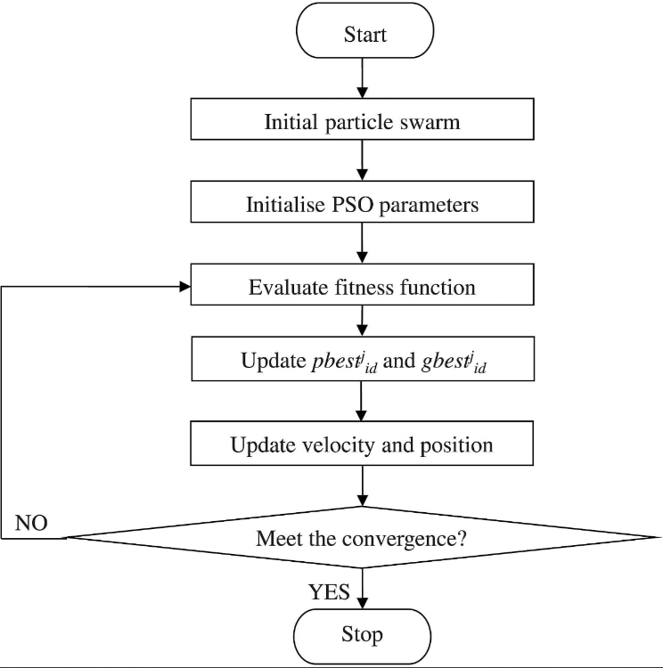
Proposed Approach / Solution
Flowchart of PSO :

Slide 5
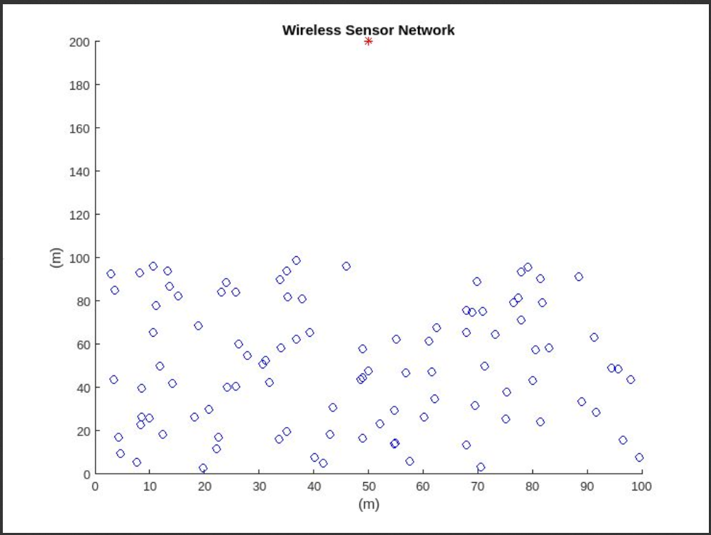
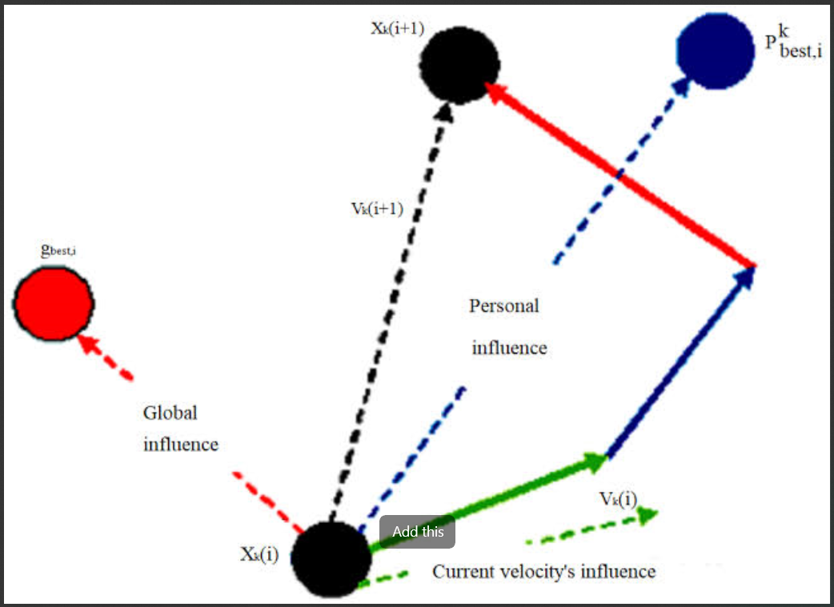
Proposed Approach / Solution
Simulation Environment :
The PSO algorithm is being used for clustering in this Wireless Sensor Network (WSN) simulation. Clustering involves grouping the network nodes into clusters based on certain criteria, such as proximity(to sink) or similarity, to facilitate efficient data aggregation, routing, and resource management in the network. PSO is employed to optimize the clustering process by finding an optimal or near-optimal arrangement of nodes into clusters, considering the objectives and constraints of the WSN simulation. By utilizing PSO, the clustering algorithm aims to improve network performance, energy efficiency, scalability, and other relevant metrics.

Slide 6
Proposed Approach / Solution
Algorithm used :
Initialize the swarm: Set the number of particles and randomly initialize their positions and velocities within the solution space.
Evaluate fitness: Calculate the fitness of each particle based on its position using a fitness function designed for the WSN simulation.
Update personal best: For each particle, compare its fitness with the fitness of its previous best position. If the current fitness is better, update the particle's personal best position and fitness.
Update global best: Compare the fitness of all particles' personal best positions and determine the global best position among them.
Update velocities and positions: Update the velocity of each particle based on its previous velocity, personal best position, and global best position. Update the position of each particle based on its previous position and the new velocity.
Convergence check: Check if the termination condition is met. Terminate the algorithm if the maximum number of iterations is reached or the desired solution accuracy is achieved.
Output the best solution: Once the algorithm terminates, output the global best position and its corresponding fitness as the optimized configuration for the WSN simulation.
Perform post-processing and analysis: Analyze the results, compare performance with other approaches or baseline configurations, and discuss insights gained from the simulation.

Slide 7
Dataset(s) Analysis / Description
Dataset Capture / Preparation / Generation :
No Dataset
Nodes and Energy Values are put randomly
Dataset Understanding / Analysis :
Node Position between 0 and 100
Energy Values between 2 and 5J
Dataset Pre-Processing / Related Challenges (if any) :
No Pre-Processing

Slide 8
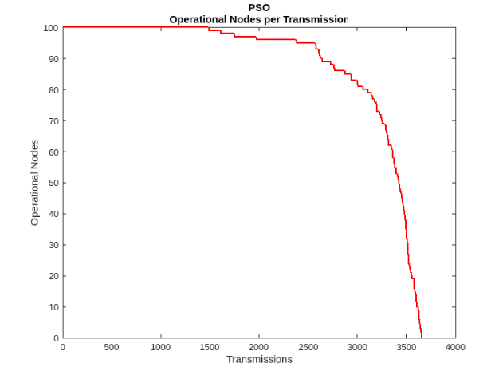
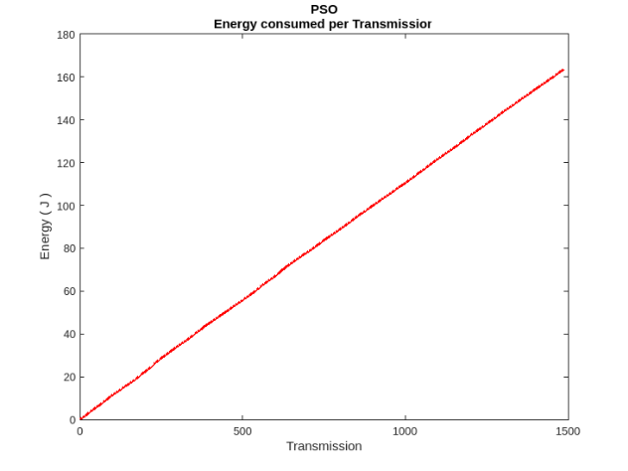
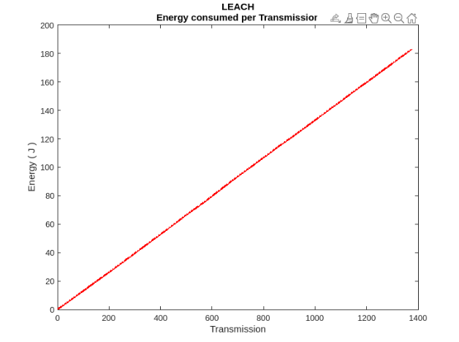
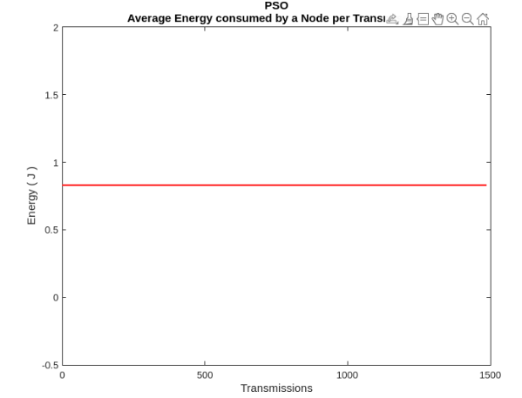
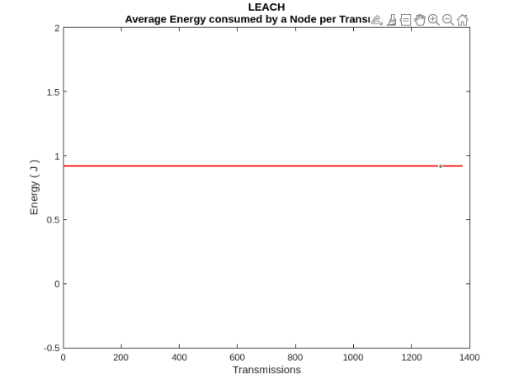
Experimental Results / Simulations / Observations
Results :

Slide 9
Experimental Results / Simulations / Observations
Major Observations / Conclusions & Challenges :
Better Energy utilization in PSO compared to Leach.
Higher Operations till all nodes die out.
Lower Energy Consumption per node for an operation.

Slide 10
Deliverable
Final Deliverables :
Simulation of WSN with all nodes, energy parameters and constrictions.
PSO algorithm for clustering and CH selection and Shortest Path for Routing.
MATLAB simulation of integrated PSO and routing.
IP / Paper Publication Plan :
Can publish a research paper on Achieving High Efficiency in WSN using different protocols and ML based PSO for clustering and Djikstras for Routing.
KPIs delivered/Expectations Met:
Understand the WSNs , its applications, deployment methods in details
Design algorithm for efficient Data collection and distribution in WSN.
Simulation of the algorithm using suitable tool.

Slide 11
Work-let Closure Details
Code Upload details:
Items | Details
KLOC (Number OF Lines of codes in 000’s) | 405
Model and Algorithm details | PSO + SHORTEST PATH ROUTING
Is Mid review, end review report uploaded on Git ? | YES, UPTO DATE
Link for Git | https://github.ecodesamsung.com/SRIB-PRISM/BMSCE_AN23BMS_Wireless_Sensor_Networks

Slide 12
Thank you

